Slide 1
NOISE POLLUTION MONITERING SYSTEM USING ARDIUNO
INTRODUCTION:
We surely can’t imagine a world without sound. Sound is one of an integral part of our day to day life, everything just becomes monotonous without the presence of audio. But too much of anything is dangerous, with the advent of automobiles, loudspeakers, etc. sound pollution has become a threat in recent days. So, in this project, we will build an IoT decibel meter to measure sound in a particular place and record the value in a graph using IoT.

Slide 2
REQUIRED COMPONENTS
ESP8266 NodeMCU Board
Microphone sensor(Sound sensor)
16*2 LCD Module
Breadboard
Connecting wires

Slide 3
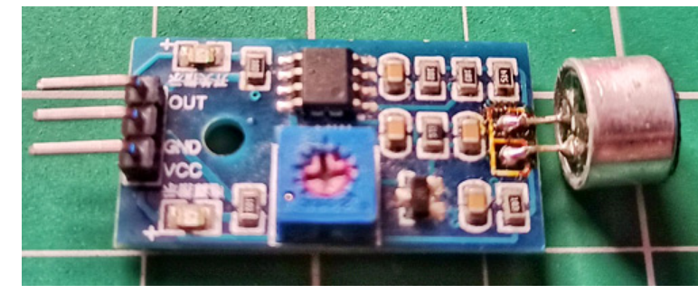
SOUND SENSOR

Slide 4
HOW DOES MICROPHONE MODULE WORK?
The microphone based sound sensor is used to detect sound. It gives a measurement of how loud a sound is. The sound sensor module is a small board that mixes a microphone (50Hz-10kHz) and a few processing circuitry to convert sound waves into electrical signals. This electrical signal is fed to on-board LM393 High Precision Comparator to digitize it and is made available at the OUT pin.

Slide 5
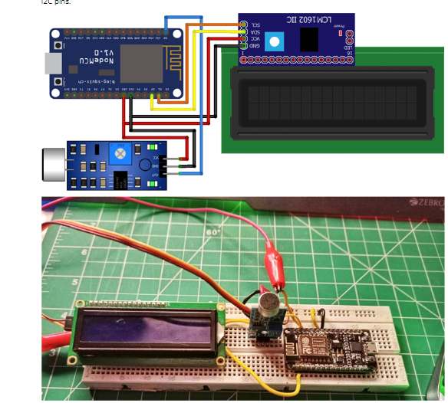
CIRCUIT DIAGRAM FOR IOT SOUND METER

Slide 6
The connections are pretty simple, we just have to connect the sound sensor to one of the Analog pin and the LCD to the I2C pins. In the above diagram, we have connected the power pins of the sound sensor and LCD display to 3v3 and GND pin of NodeMCU. Along with that, we have also connected the SCL and SDA pins of the module to D1 and D2 respectively, and the OUT pin of the sound sensor to A0 pin.

Slide 7

SOUND POLLUTION DATA

Slide 8
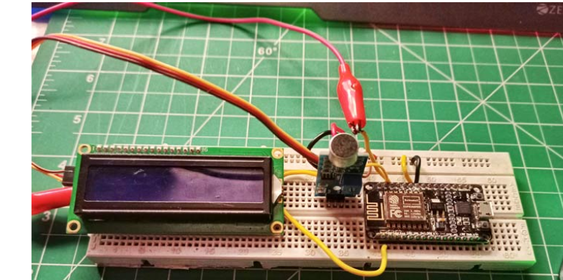
CIRCUIT CONNECTOIN

